Slide 1
Anything but simple:
Using models and field studies to explore impacts of cropping system diversification in the US Corn Belt
Gina Nichols
PhD Defense
August 25 2021

Slide 2
What I did
Why I did it

Slide 3
2018-present
Nichols et al. (in prep) Roots as drivers of the rotation effect in maize?
Nichols et al. (in prep) Using models to unravel causal mechanisms of the continuous maize penalty
Nichols & MacKenzie (in prep) Decision analysis to target cover crop research priorities in Central Iowa
Nichols et al. (in review) Winter cover cropping effects on soil water storage vary by site: Field measurements and a proposed causal model
Nichols et al. (2020). Effect of long-term cover-cropping on weed seedbanks. Frontiers in Agronomy
Nichols et al. (2020) Cover crops and weed suppression in the U.S. Midwest: A meta‐analysis and modeling study. Agricultural and Environmental Letters
Weisberger*, Nichols *, Liebman (2019) Does diversifying crop rotations suppress weeds? A meta-analysis. PloS one
Nichols et al. (2019) Maize root distributions strongly associated with water tables in Iowa, USA Plant and Soil
Bird, Nichols, et al. (in review). Means, motive, and opportunity: A stakeholder analysis method to understand likelihood of action in food-energy-water systems. Elementa
Pasley, Nichols, et al. (2021). Rotating maize reduces the risk and rate of nitrate leaching. Environmental Research Letters.
Archontoulis, Castellano, Licht, Nichols, et al. (2020) Predicting crop yields and soil-plant nitrogen dynamics in the US Corn Belt. Crop Science
Liebman & Nichols (2020) Cropping system redesign for improved weed management: A modeling approach illustrated with giant ragweed (Ambrosia trifida). Agronomy
Martinez-Feria, Nichols, et al. (2019) Can multi-strategy management stabilize nitrate leaching under increasing rainfall? Environmental Research Letters

Slide 4
Longer rotations may benefit corn roots
Rotating corn reduces the risk of nitrate leaching
Cropping systems with more variation in planting dates have less weeds
Cover crops can effectively complement herbicides
(Cover crop termination – corn planting) window is where producers are exposed to the most risk

Slide 5
Longer rotations may benefit corn roots
Rotating corn reduces the risk of nitrate leaching
Cropping systems with more variation in planting dates have less weeds
Cover crops can effectively complement herbicides
(Cover crop termination – corn planting) window is where producers are exposed to the most risk

Slide 7


Slide 8
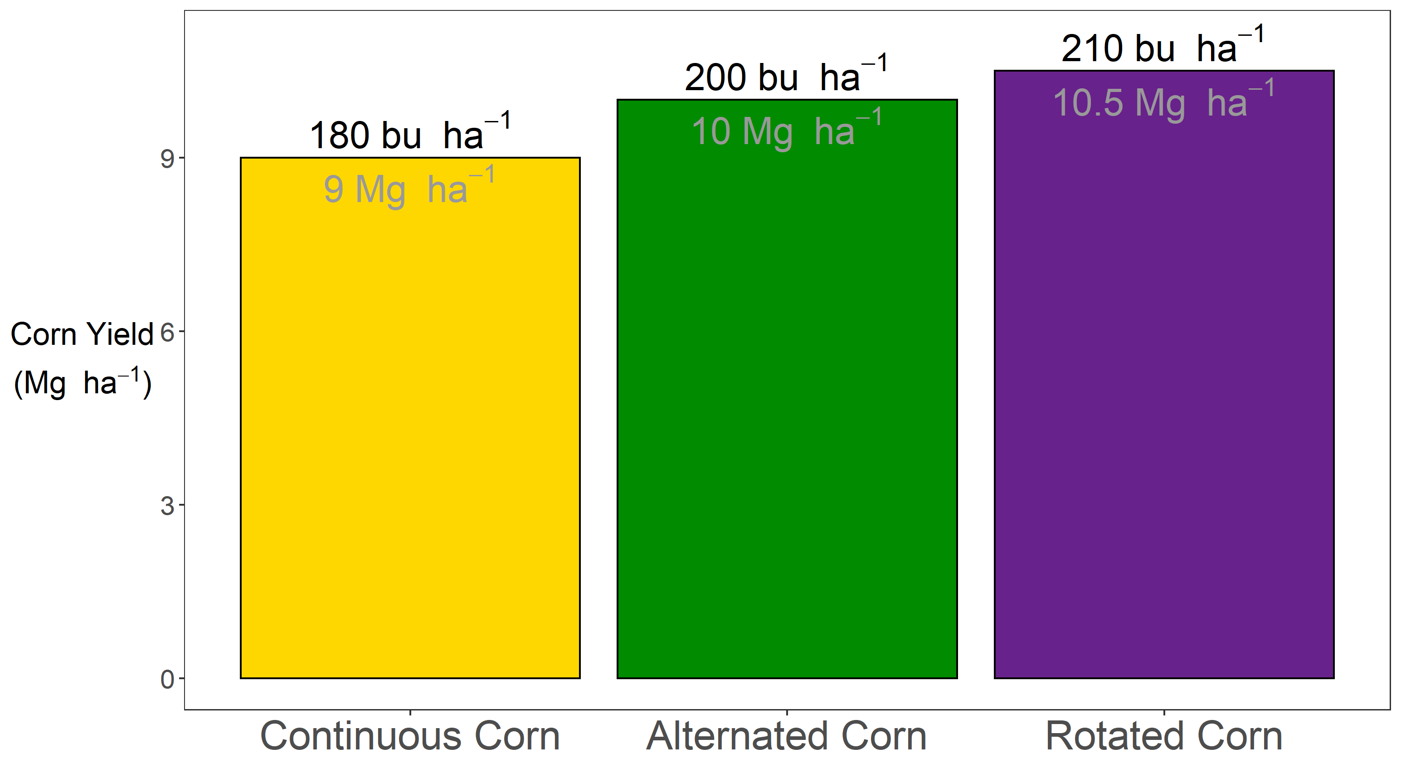

Slide 9


Slide 10
?

Slide 11


Slide 12
Agronomist (noun):
A person who is continuously fascinated by how corn responds to nitrogen

Slide 13
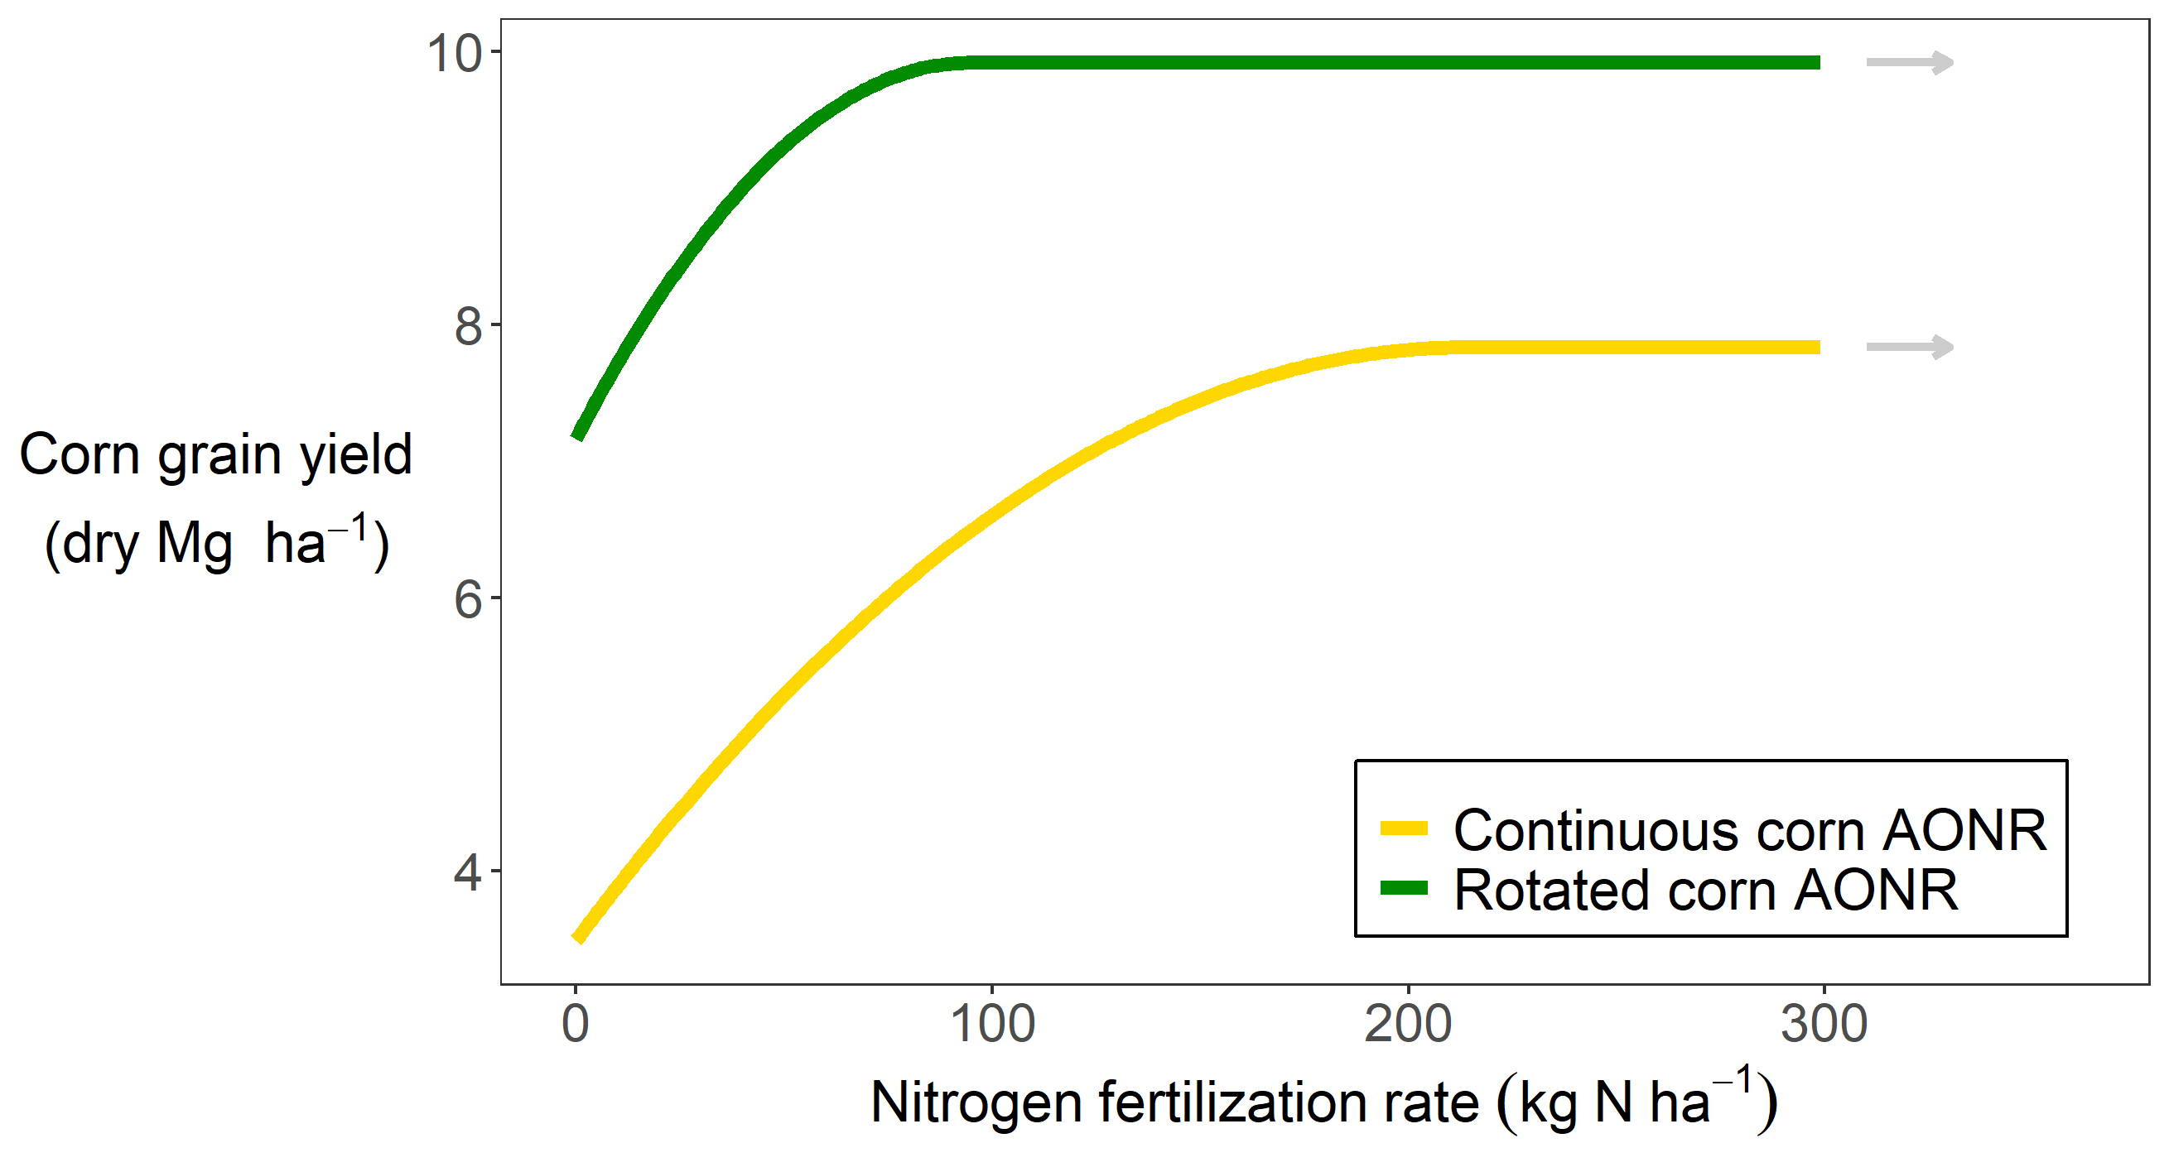

Slide 15
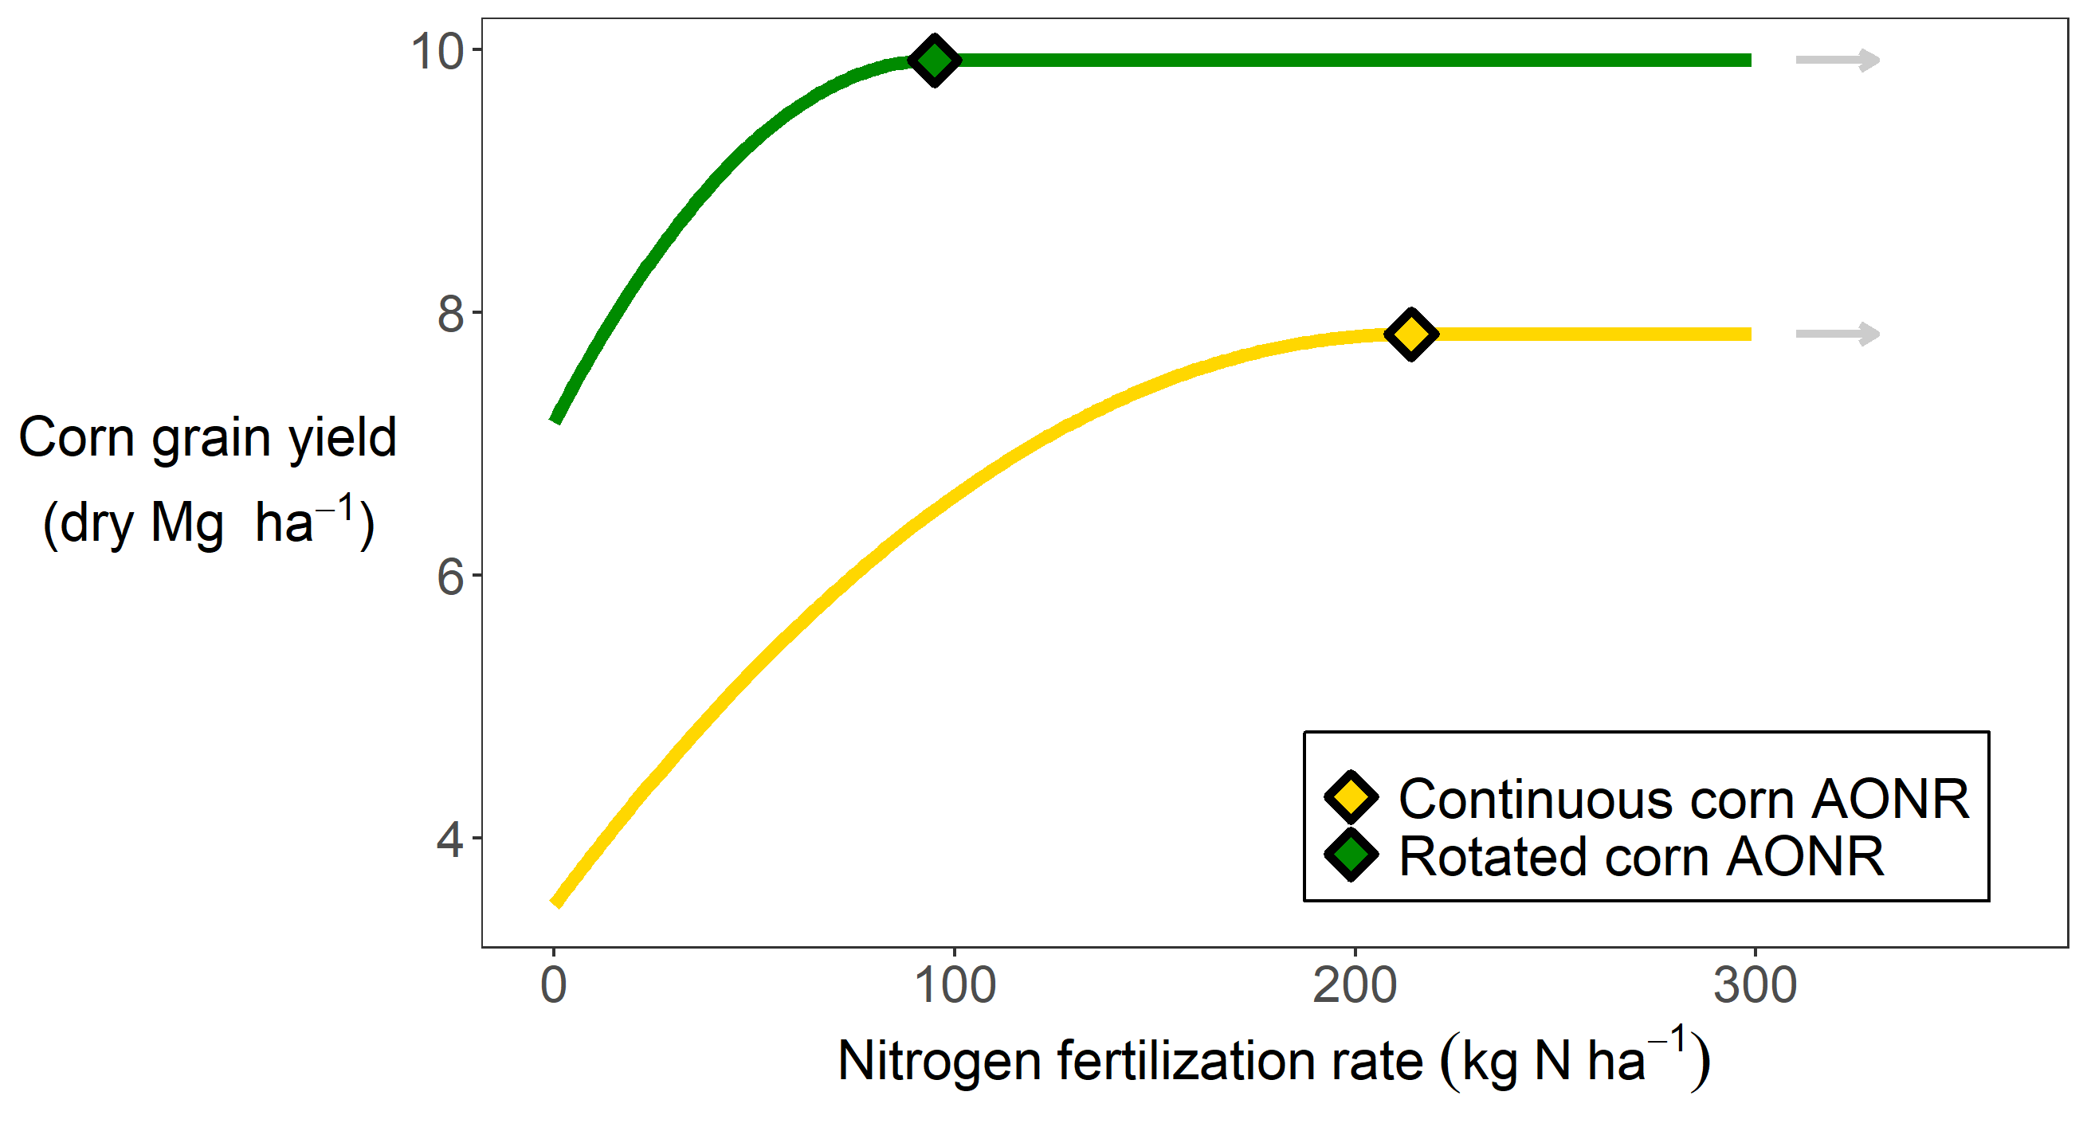

Slide 16
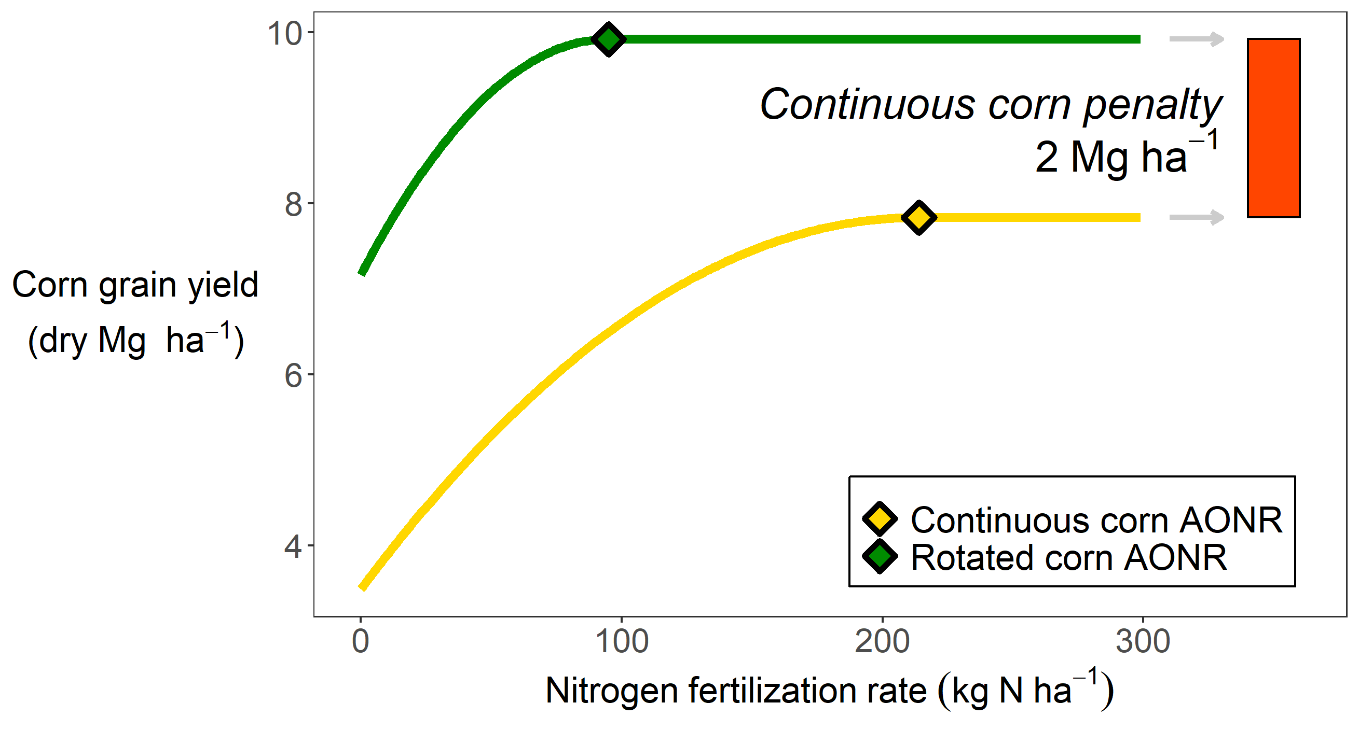

Slide 17
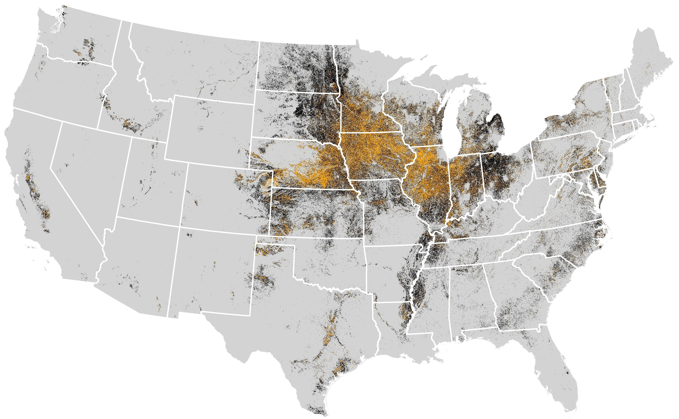
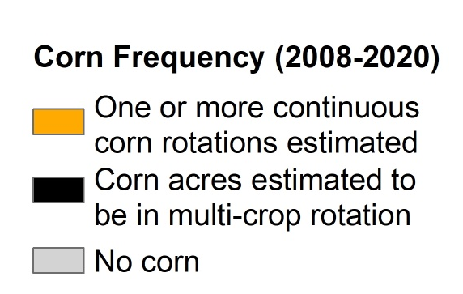
Cont corn map
Map courtesy of Jess Nelson
Data Source: https://www.nass.usda.gov/Research_and_Science/Cropland/Release/index.php

Slide 19
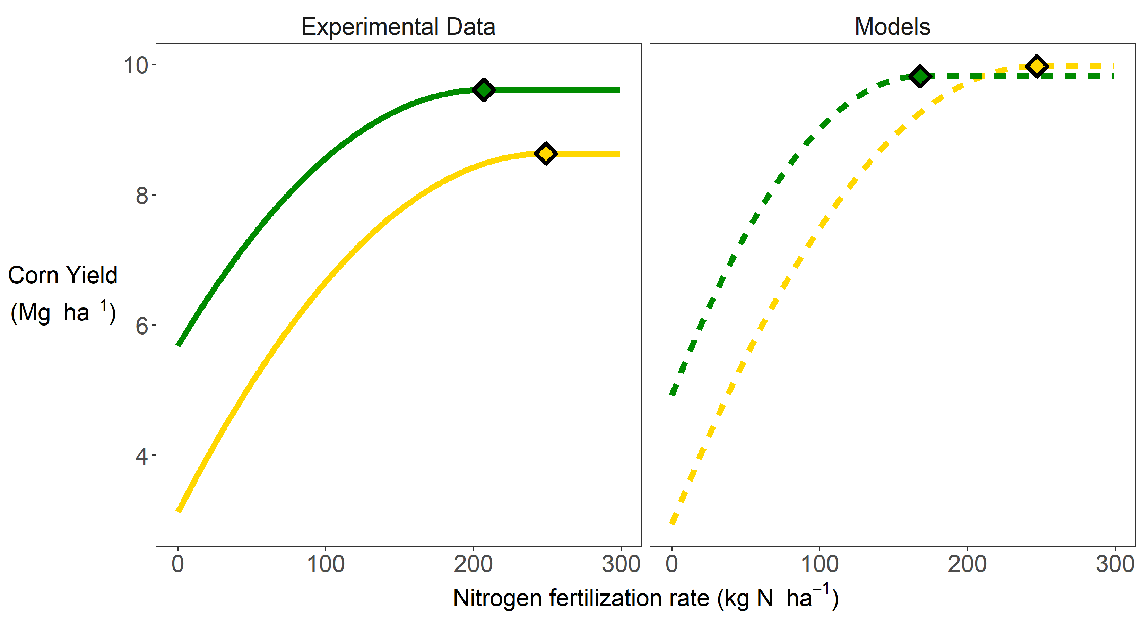

Slide 20
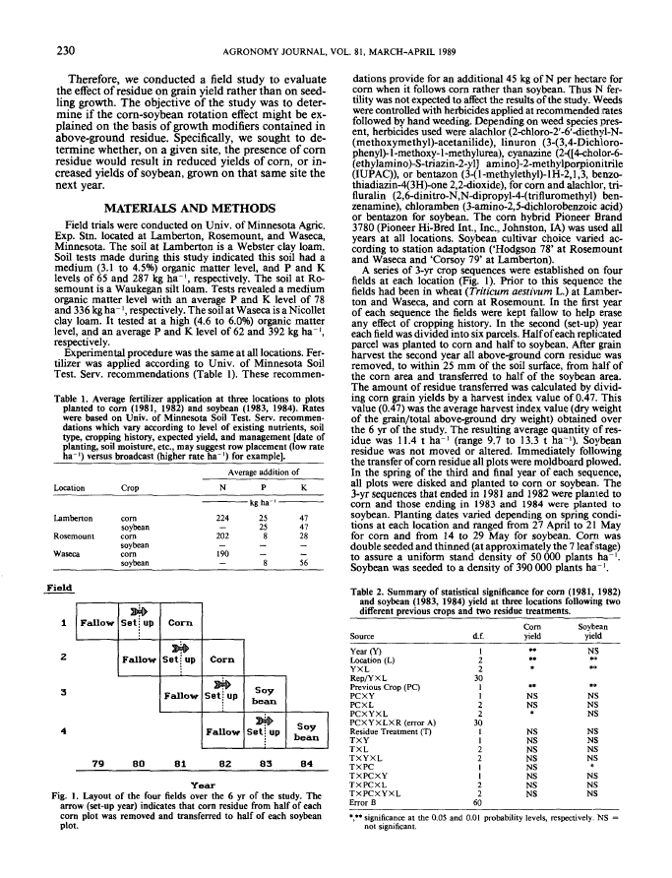
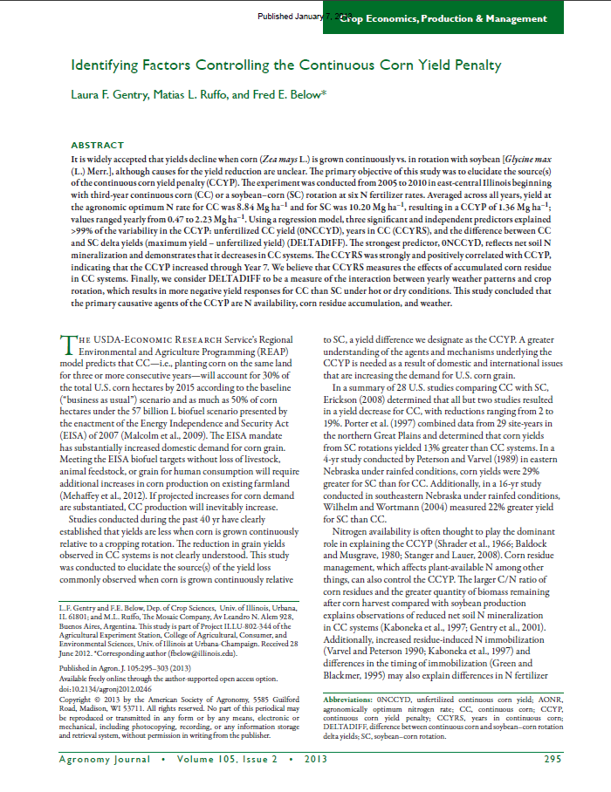
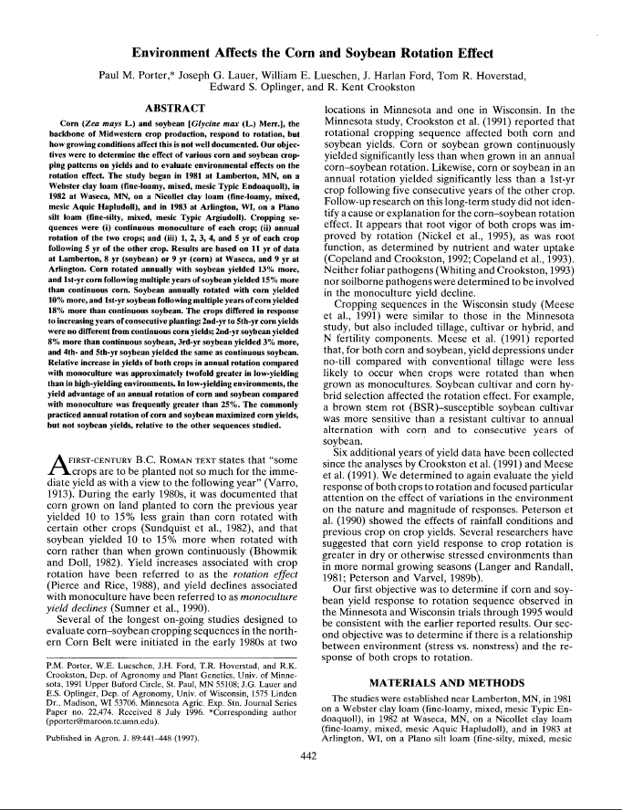

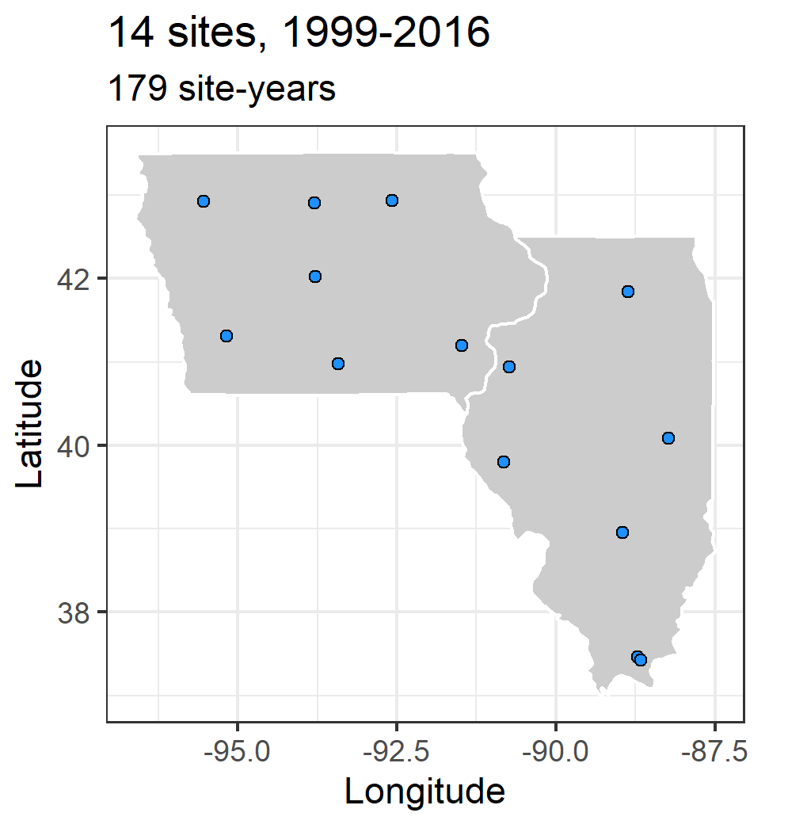

Slide 21
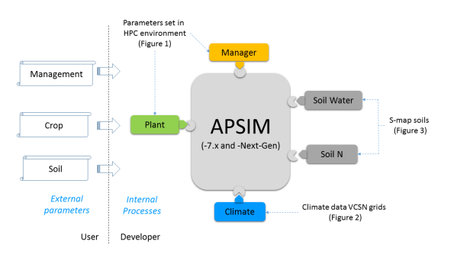
Explain APSIM?

Slide 23
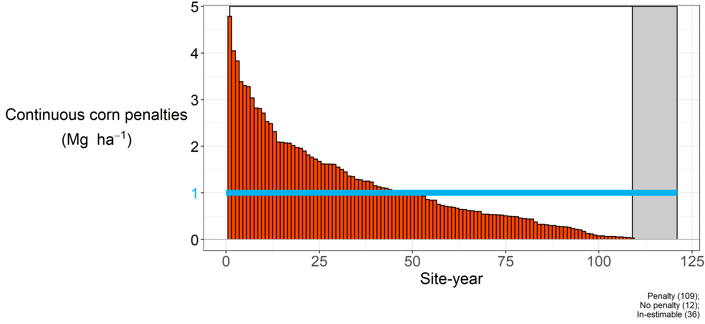
90% of site-years had a penalty at sufficient N

Slide 24
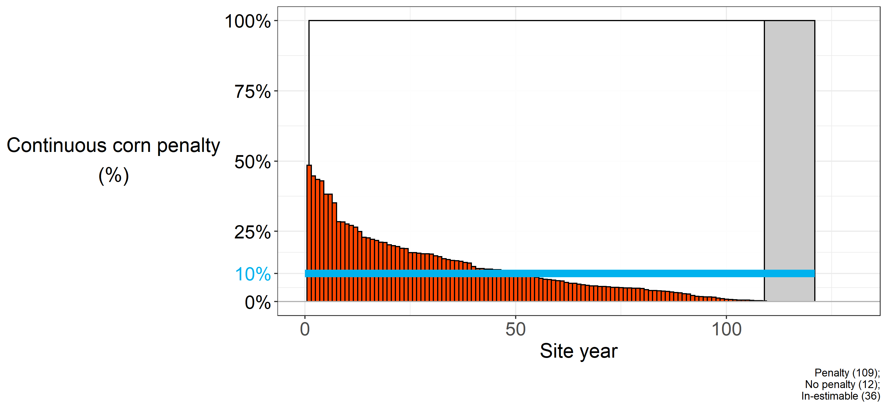
Continuous corn penalty ~10% (0-50%)

Slide 25
Fishing expedition
Cold days
Amount of rain before planting
Residue

Slide 26
Hypothesis
Insufficient soil water recharge following maize
Altered nitrogen cycling
Seedling death
Delayed emergence
Foliar disease
Compromised root growth
Compromised root function
Decreased early plant growth

Slide 27
Hypothesis | Model
Insufficient soil water recharge following maize | Not supported
Altered nitrogen cycling | In progress…
Seedling death | Change planting density
Delayed emergence | Change sowing depth
Foliar disease | Change plant parameter
Compromised root growth | Change plant parameter
Compromised root function | Change plant parameter
Decreased early plant growth | Change plant parameter

Slide 28
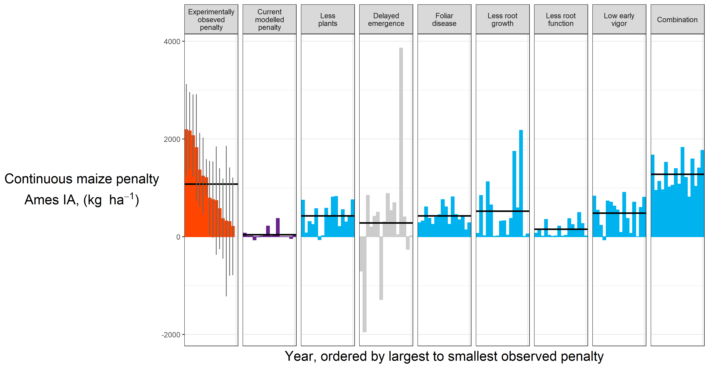
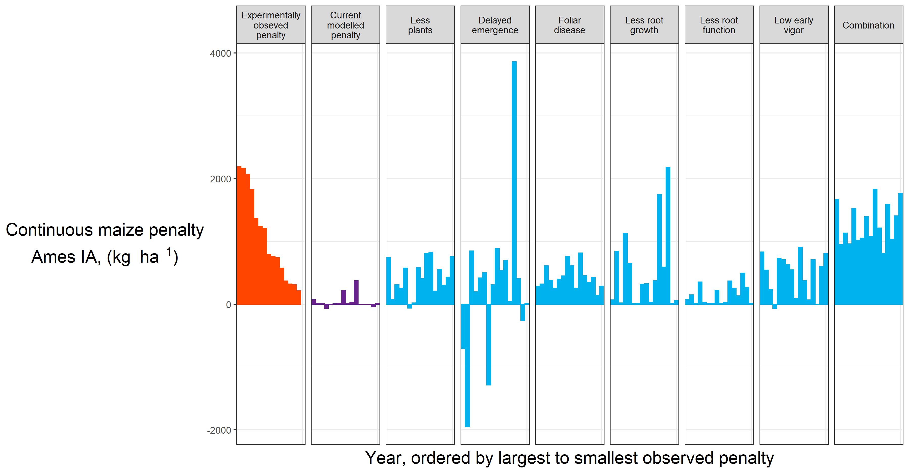
Results

Slide 29

Results

Slide 30
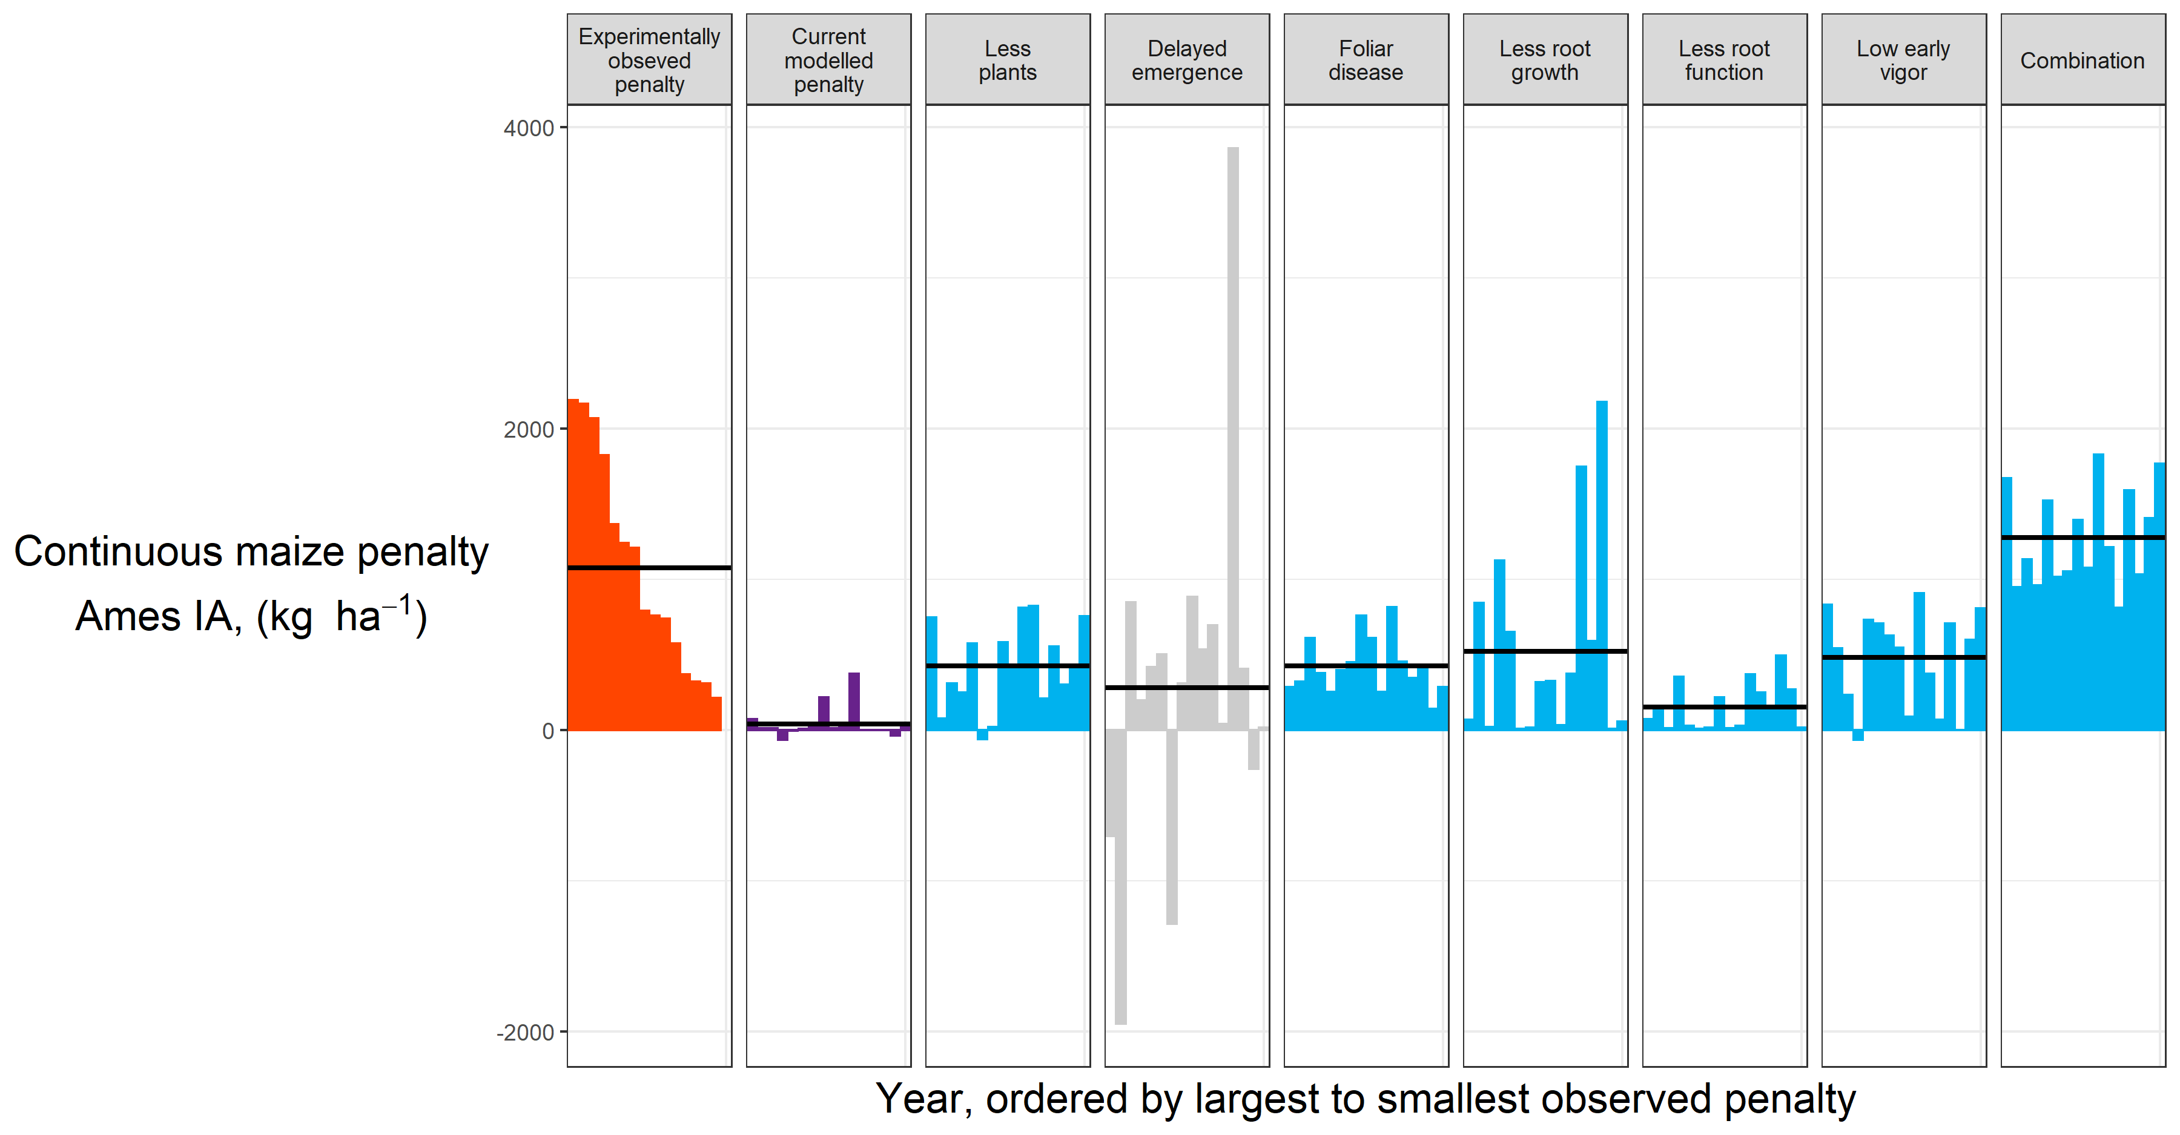
Results

Slide 31
Results

Slide 32
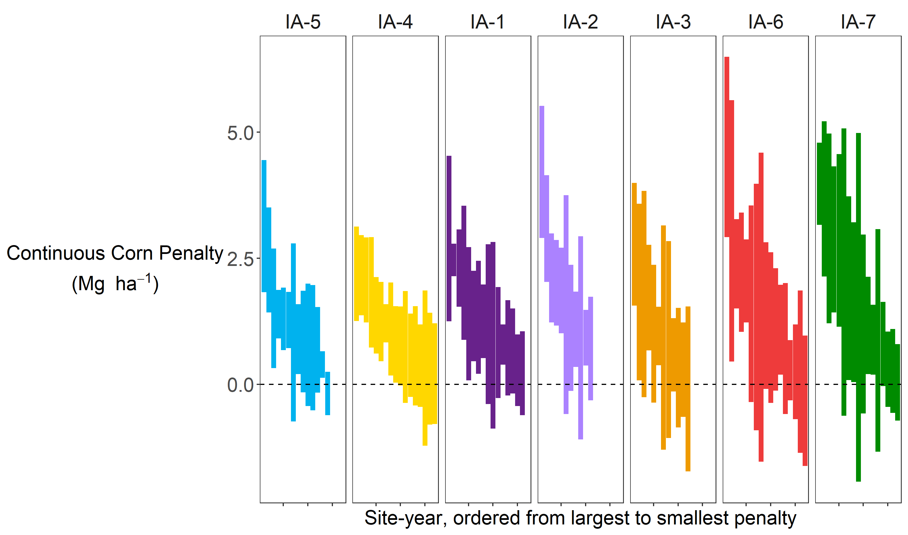
Noise
Noise from plot harvester
Noise between replicates
Noise from manager
All the interactions…

Slide 33
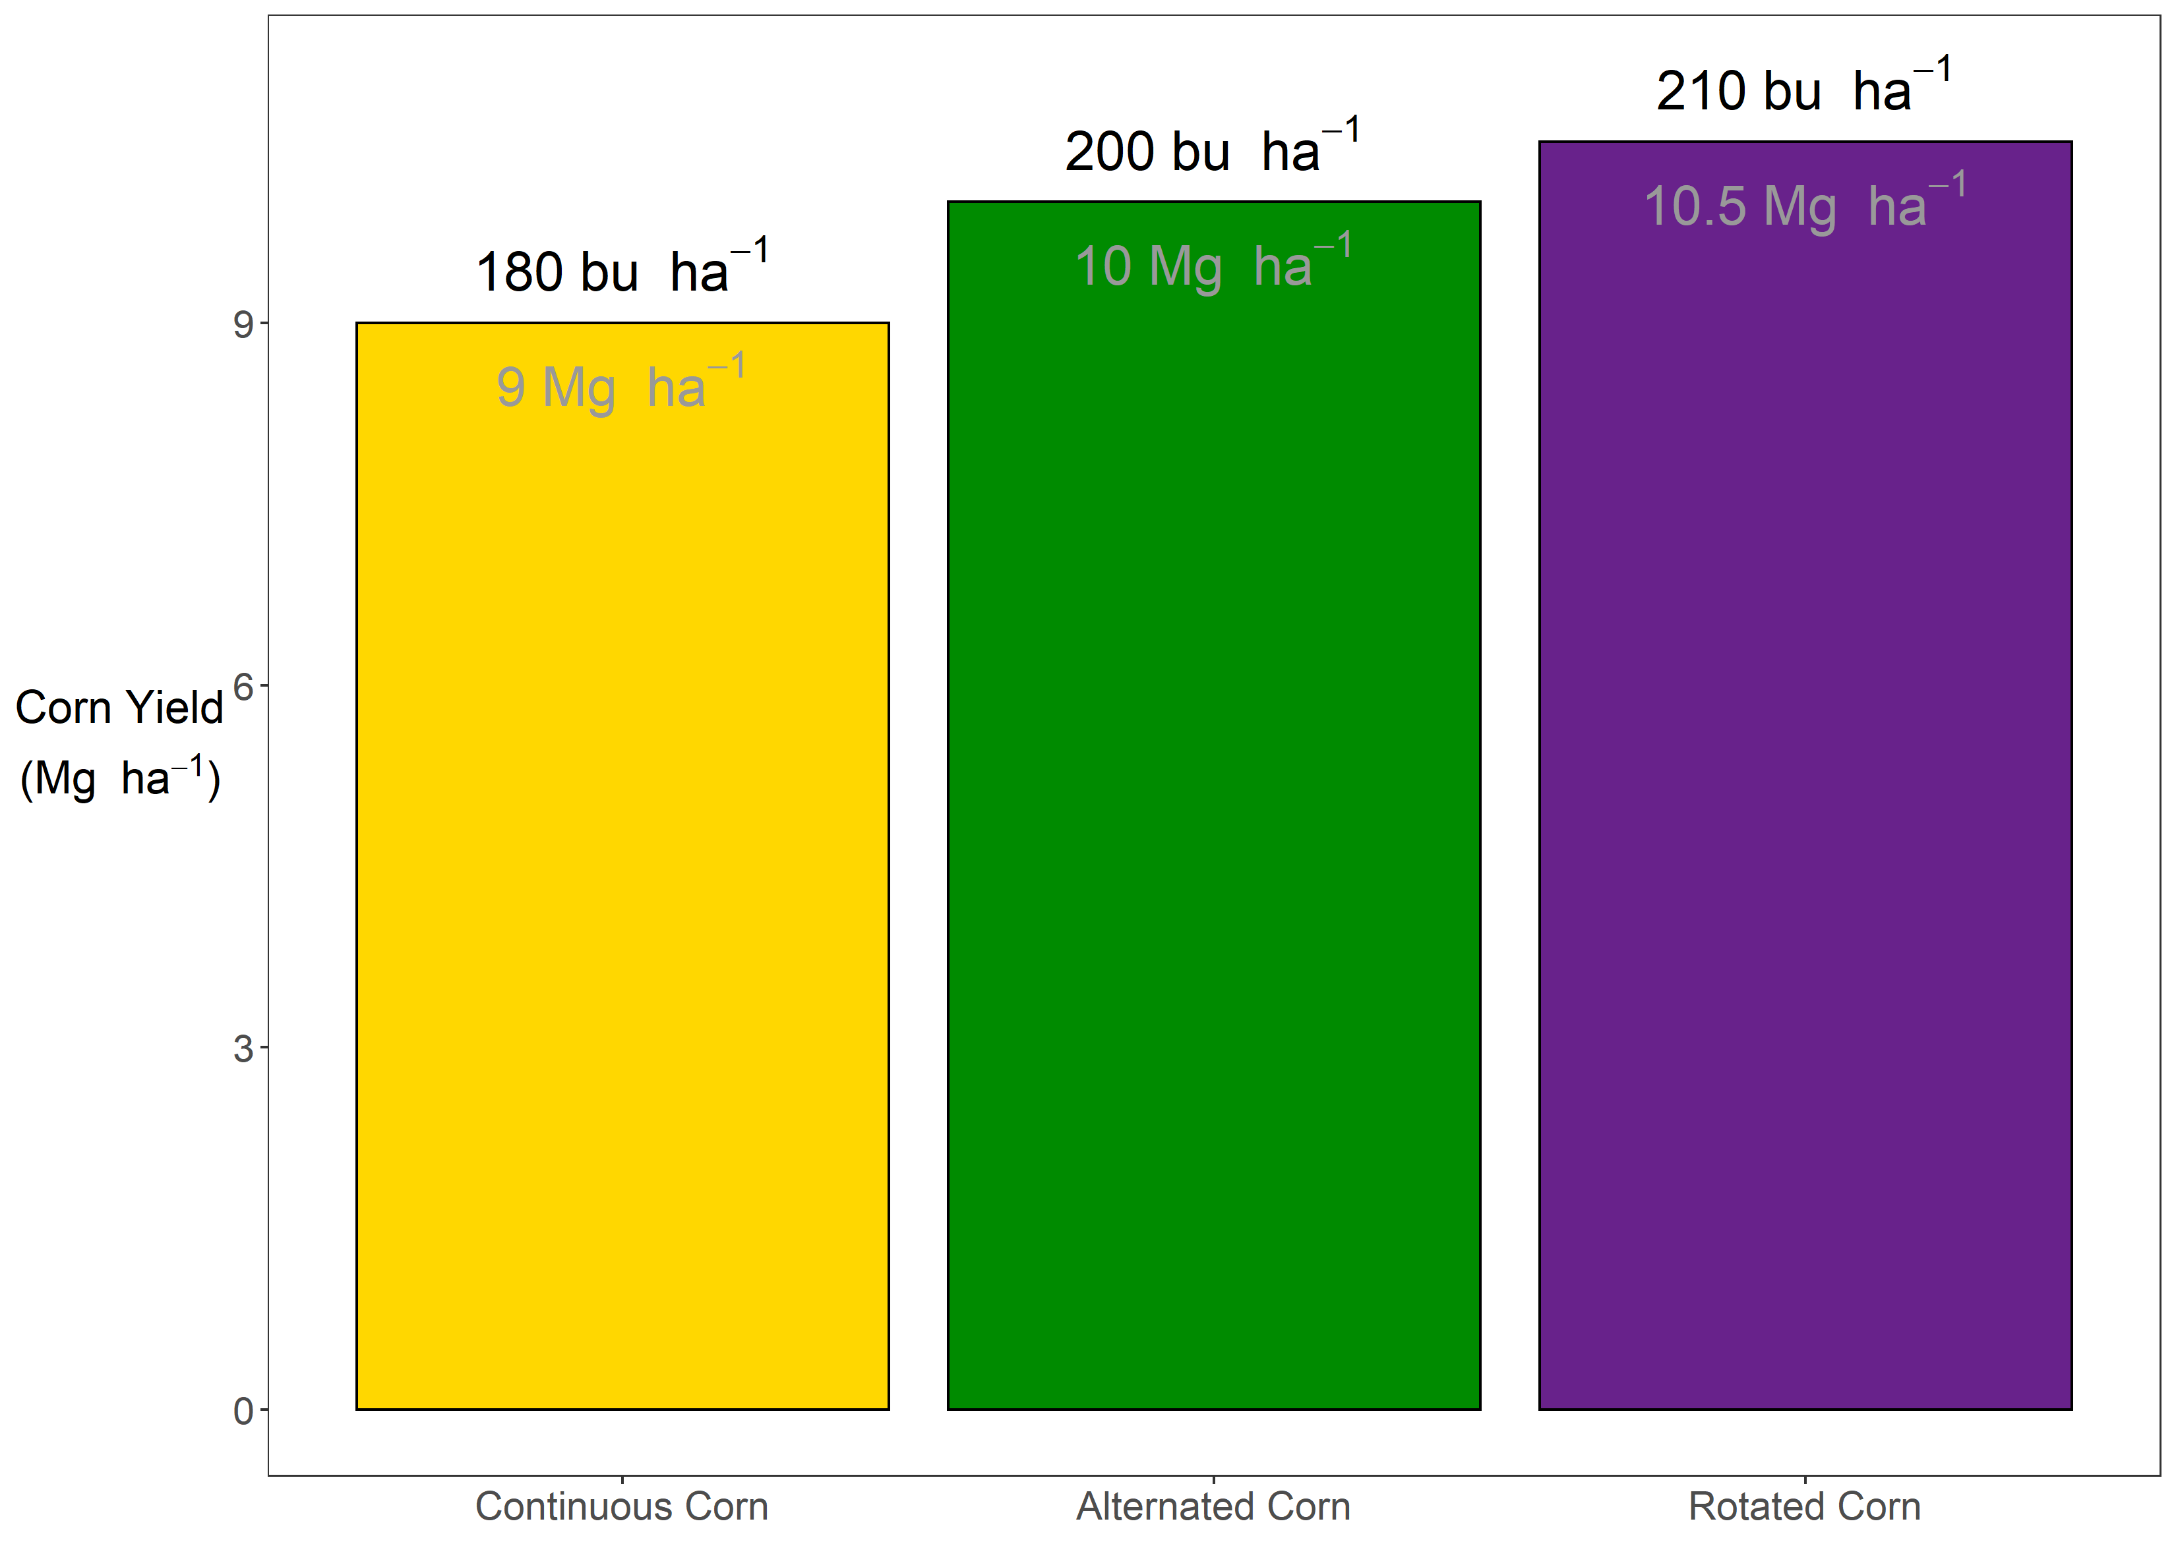
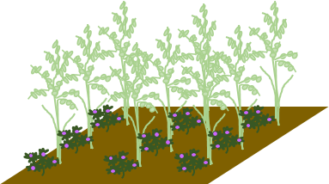
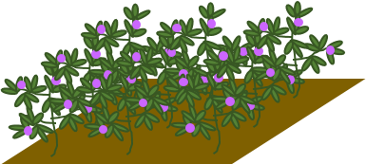

Slide 34
Suite of field msmts

Slide 35
Yields, root depth, root mass?

Slide 36
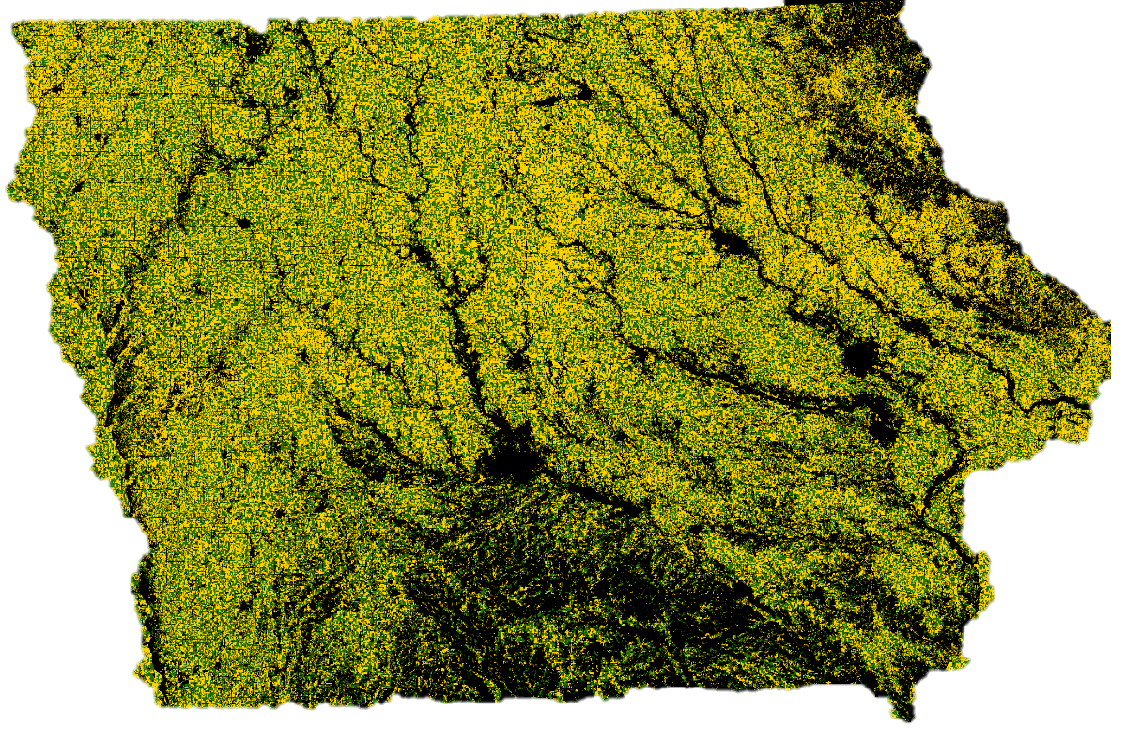
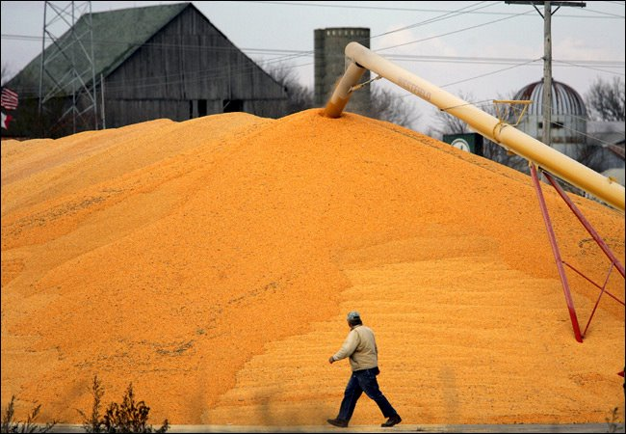

Slide 37




Slide 38
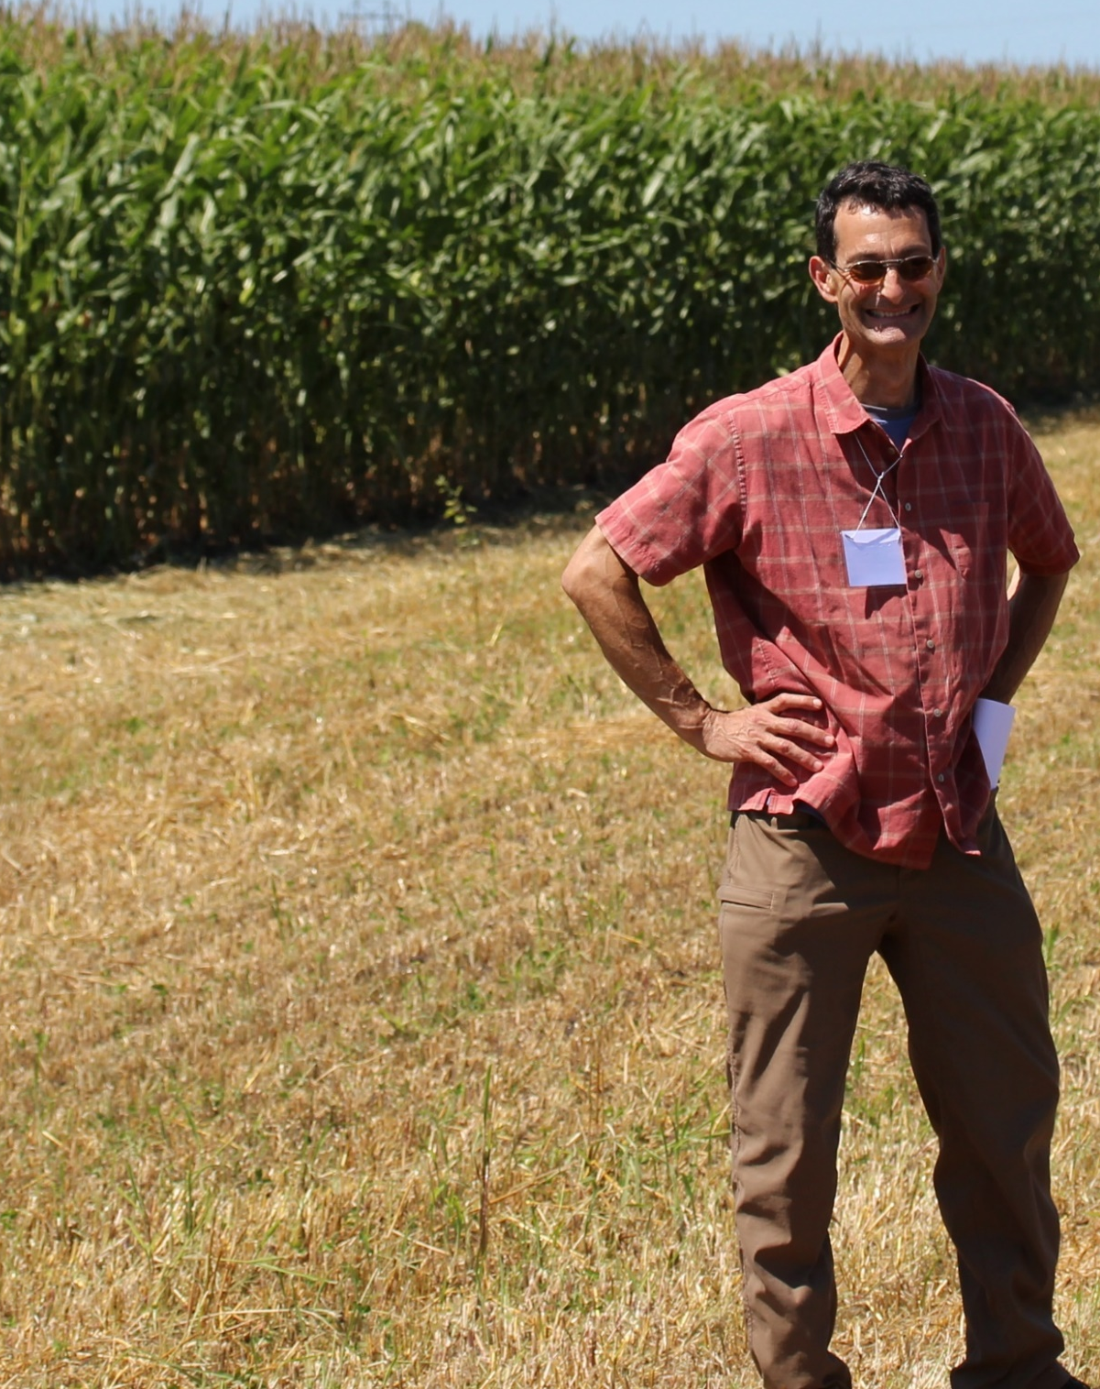

Slide 39
Extras

Slide 40
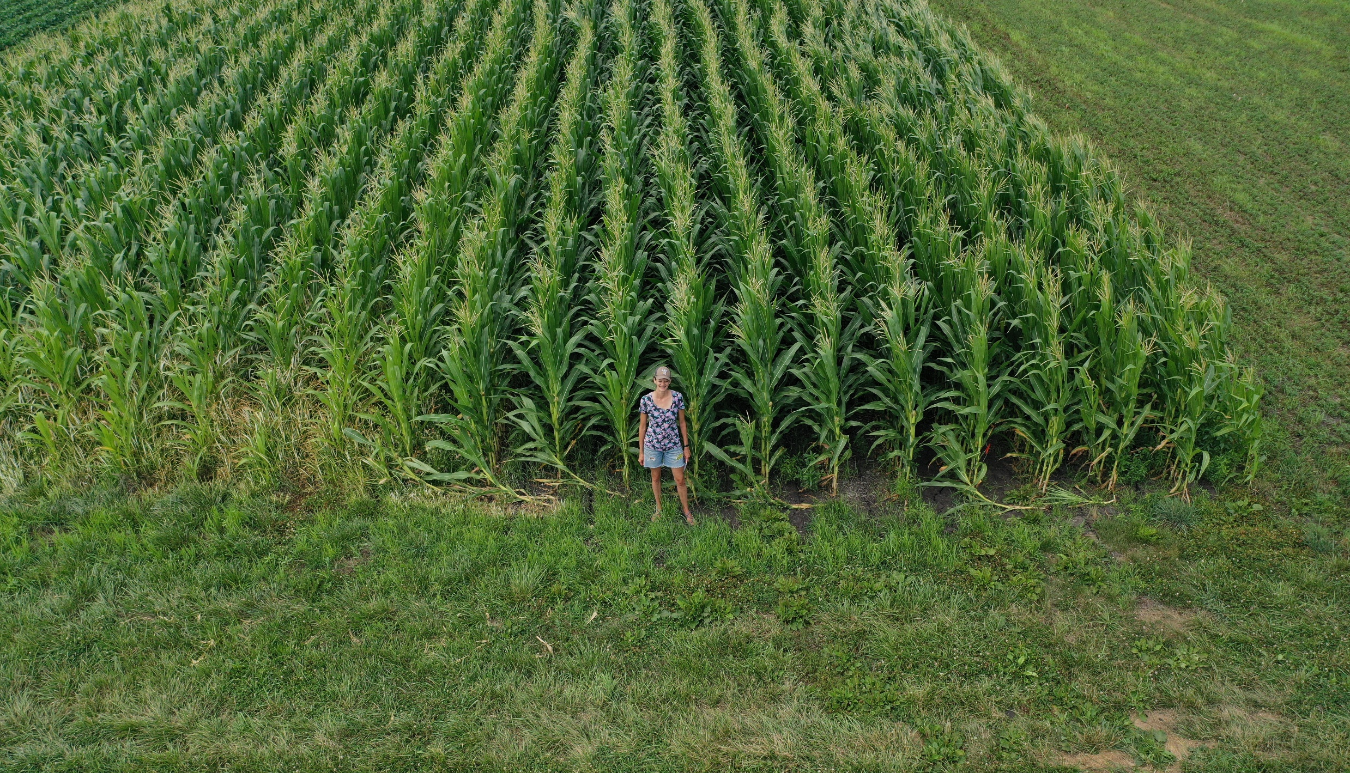

Slide 41
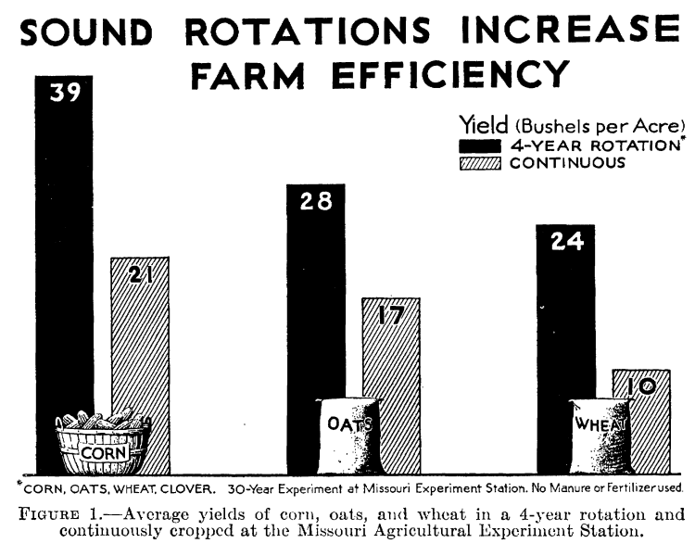
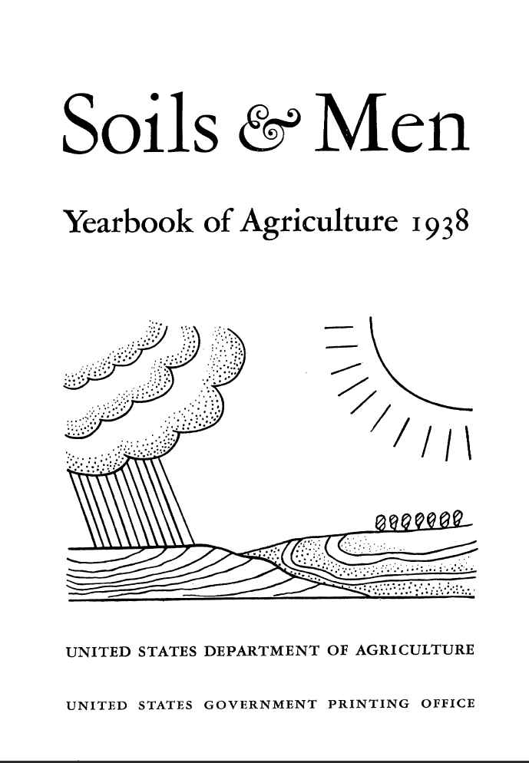

Slide 42
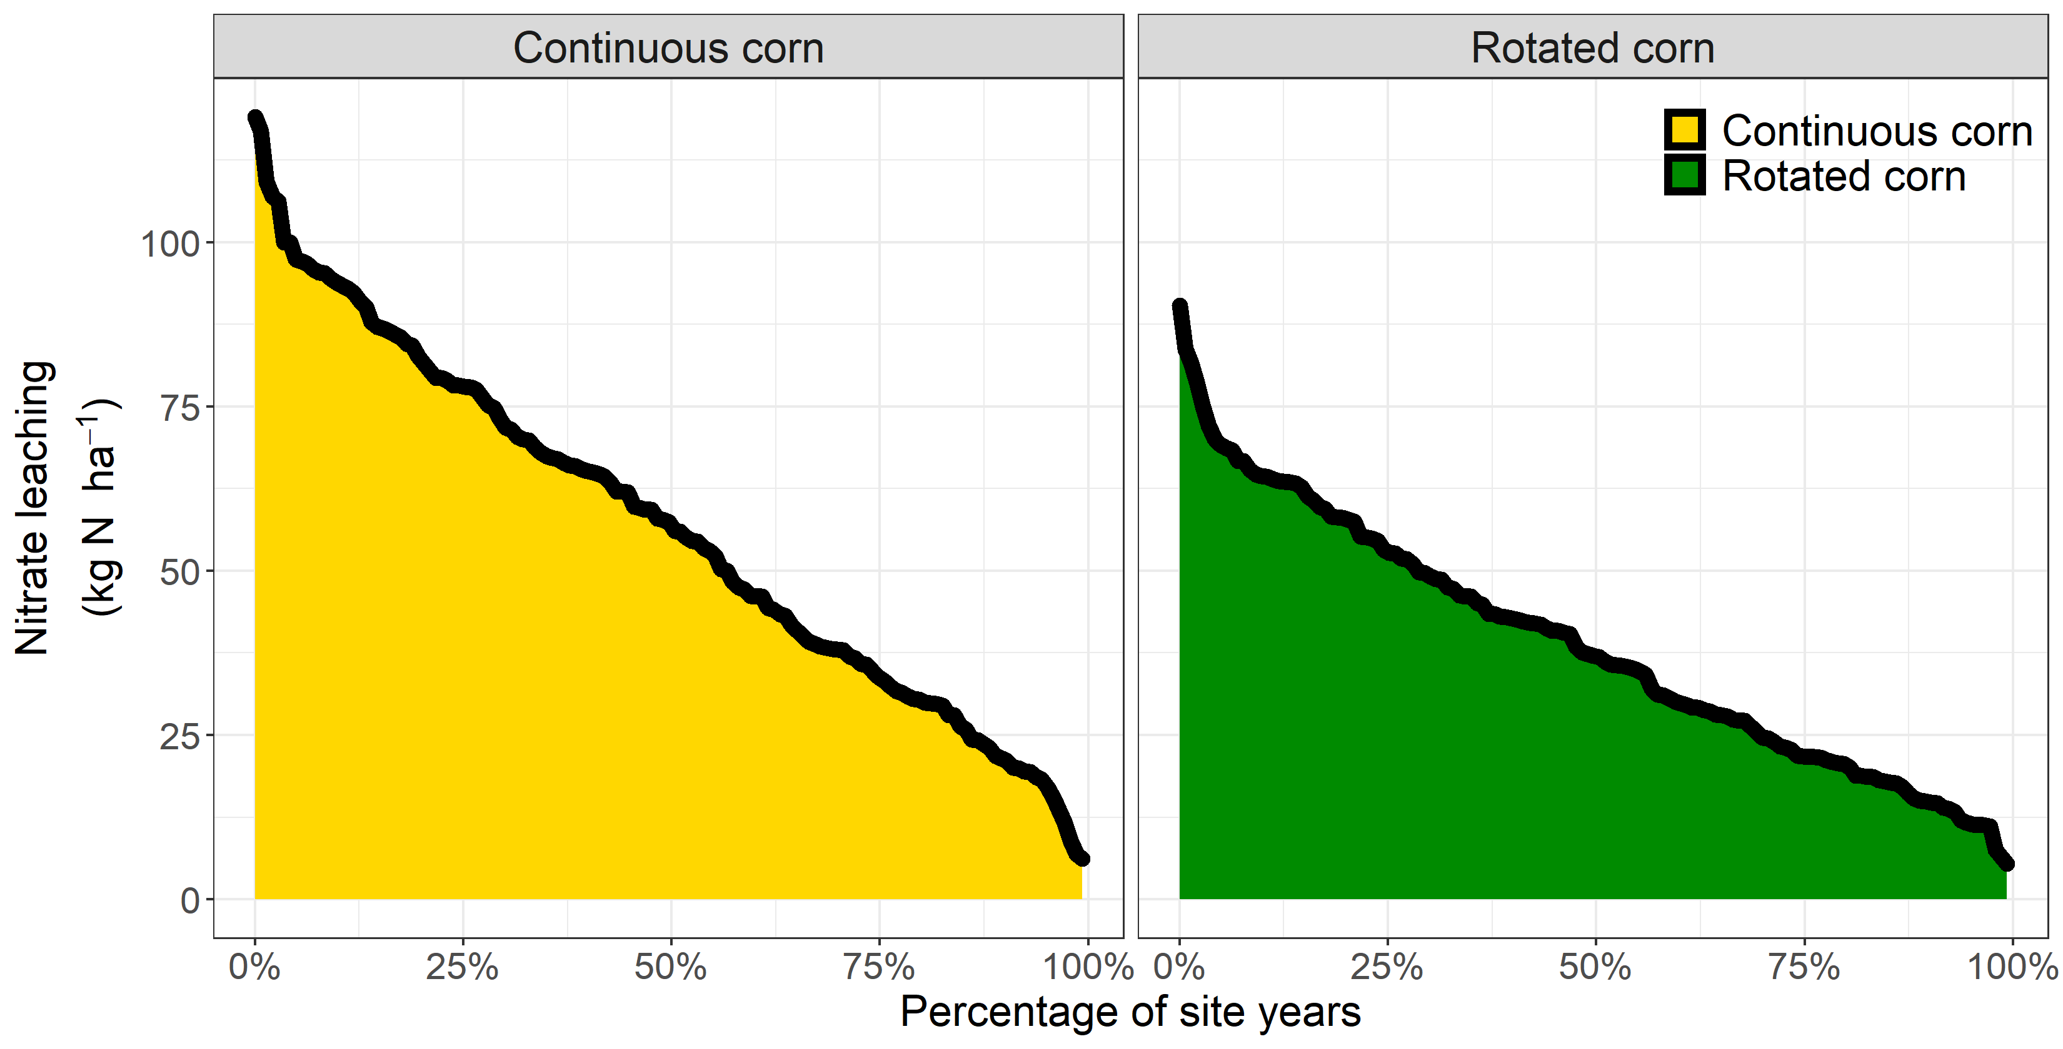
8 sites, 151 site-years, modeled nitrate leaching at 150 and 200 kg N application

Slide 43
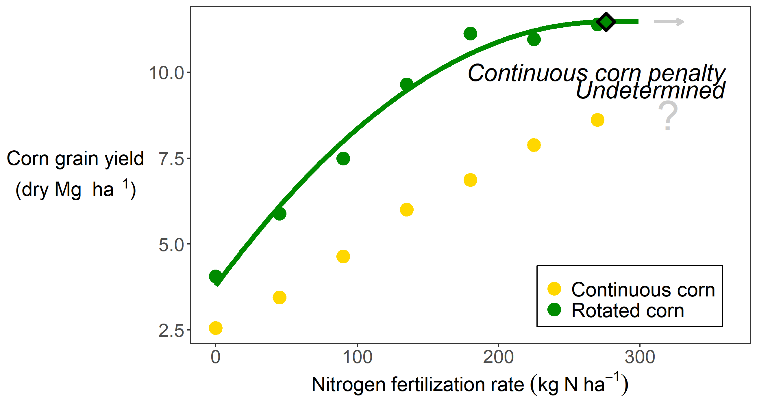
Example of undetermined penalty

Slide 44
